Slide 2
TABLE OF CONTENTS
INTRODUCTION
GENERAL OUTLINE OF COMPANY
MISSION STATEMENTS
VTE SERVICES
ORGANIZATION CHART
COMPLETED PROJECTS
CURRENT PROJECTS
QA/QC MANUAL
HSE POLICY

Slide 3
INTRODUCTION
Viettien Engineering Joint Stock Company is a Mechanical & Electrical Contractor for all kinds of buildings, factories and plants. We provide engineering services including design and installation of mechanical, electrical and instrumental systems to the construction industry. Project management service is one of our strength. Besides, we supply a wide range of high quality lights. Founder in November 2004, we have been engaged in a significant number of construction projects in Vietnam. These projects have given us such valuable experiences and we have an utmost confident that we can satisfy our clients in regards to price, quality and service thereof. Viettien Engineering perceives that the client's relibability and credit are the key elements for its solidity.

Slide 4
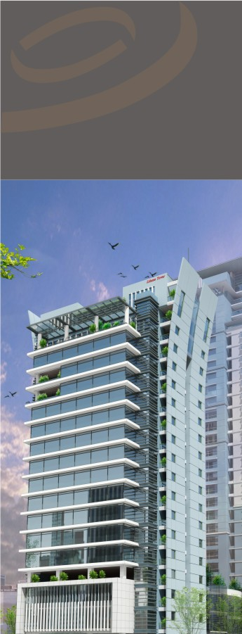
GENERAL OUTLINE OF COMPANY
Name
VIET TIEN ENGINEERING JOINT STOCK COMPANY
Head office
8th floor , HCMCC Tower 249A Thuy Khue str.
Tay Ho District, Hanoi , Vietnam
Tel: +84 4 6258 4010/+84 4 6258 4100
Fax: +844 6258 4081
Branch office
Unit 601 131 Bui Thi Xuan Building.
Bui Thi Xuan Street, Hai Ba Trung District, Hanoi , Vietnam
Tel: +84 4 39748243
Fax: +844 39748243
Website: www.vte.vn
Business License No. 0103005857 issue by Hanoi Department of Planning and Investment on 5th November 2004
Mr Nguyen Tuan Anh – General Director
Location
Company Registration
Representative

Slide 6
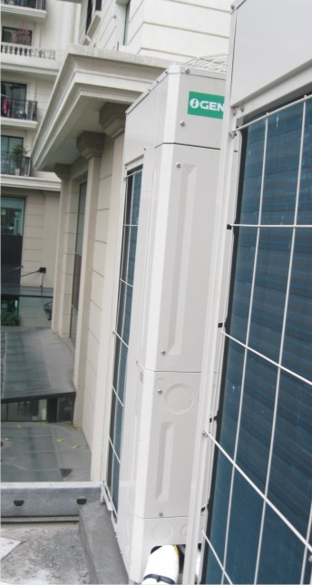
VTE SERVICES
Air-conditioning and Mechanical Ventilation
Design and Build Air-conditioning and Mechanical Ventilation System
Central Chilled Water Air-conditioning System for Office Buildings, Hotels, Retail, Industrial Buildings and Industrial Plants
Thermal Energy Storage System
Split, VRV Air-conditioning System for Office Buildings, Residential and Industrial Plants
Air-conditioning and Mechanical Ventilation System for Luxurious Resorts incorporating Heat Recovery System
Smoke Control System
Energy Efficient Air-conditioning System
Electrical Services
Design and Build High Tension and Low Voltages Electrical System
High Tension Electrical System for Office Buildings, Hotels, Retail, Industrial
Low Tension Electrical System for Office Buildings, Hotels, Retail, Industrial Buildings and Industrial Plants
Extra Low Voltage System comprising of CCTV System, Public Address System, Telephone system, Data system, Access System

Slide 7
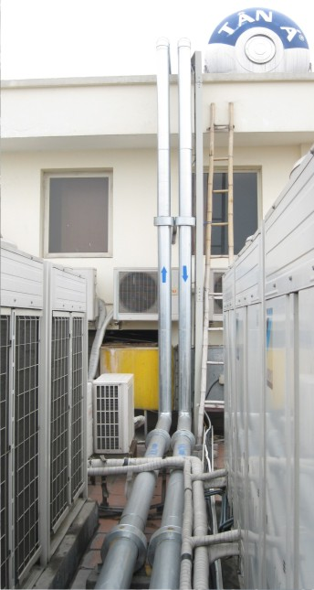
VTE SERVICES
Fire Prevention and Protection System
Design and Build of Sprinkler System complying to international and Vietnamese Standards
Sprinkler System for High Rise Offices, Hotels, Retail, Industrial Buildings and Industrial Plants
Hose Reel System for High Rise Offices, Hotels, Retail, Industrial Buildings and Industrial Plants
Wet and Dry Riser System for High Rise Offices, Hotels, Retail, Industrial Buildings and Industrial Plants
Design and Build Fire Alarm System complying to the International and Vietnamese Standards.
Installation of Fire Alarm System for High Rise Offices, Hotels, Retail, Industrial Buildings and Industrial Plants
Design and Build Fire Suppression Systems Foam Systems, etc. for Data central.

Slide 8
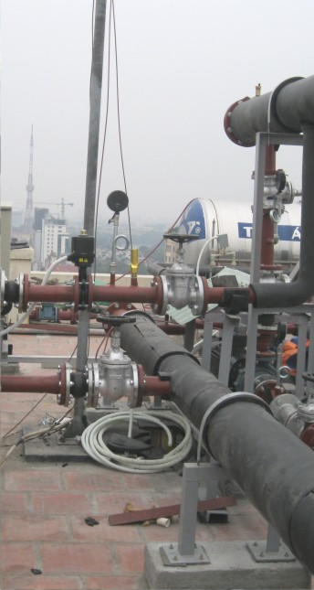
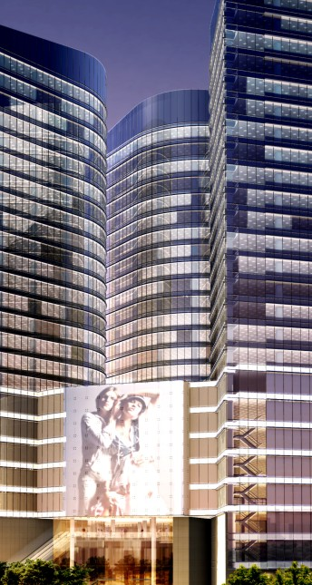
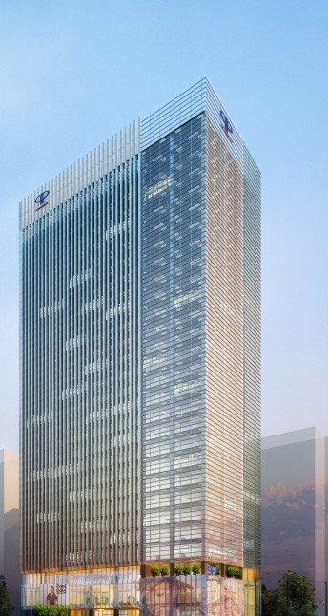
VTE SERVICES
Plumbing and Sanitary Works
Design and Build Cold Water and Hot Water Distribution System and Sanitary System complying to the local International Standards, Vietnamese Standards and WHO Standards
Cold Water and Hot Water Distribution System consisting of Pumps, Water Tanks, Distribution Pipe work, etc. for Office Buildings, Hotels, Retail, Industrial Buildings and Industrial Plants
Heat Pumps consisting of Storage Tanks, Calorifiers and Hot Water Distribution System
Sanitary System consisting of Sewage pumps and Sump Pumps for Office Buildings, Hotels, Retail, Industrial Buildings and Industrial Plants
Design and Installation of Rain Water Harvesting and Collection System
Design and Installation of Sewage Treatment Plant and Waste Management Systems
Design and Installation of Gas Systems for Central Source or Bottled Gas Systems

Slide 9
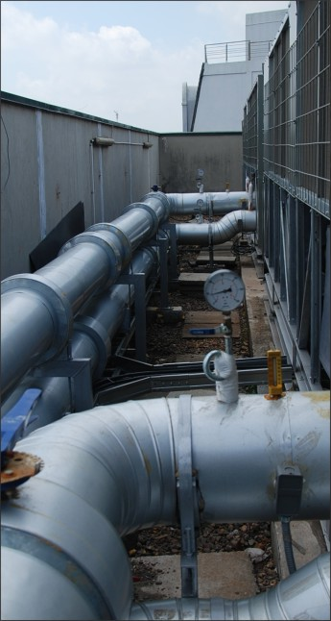
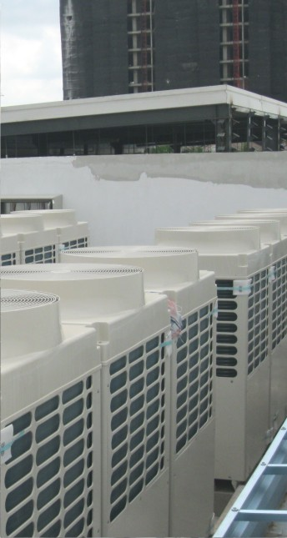
VTE SERVICES
Co-ordination Building Services
Design and Build of Mechanical and Electrical Systems
Installation of complete MEP services for Office Buildings, Hotels, Retail, Industrial Buildings and Industrial Plants
Providing Integrated Co-ordination of MEP Services, enhancing onsite installation and savings on eventual energy usage by ensuring co-ordinated, optimum electrical provisions
Providing Single-Point Management and Co-ordination of the total MEP Service
MEP Special Equipments Trading
Special Lighting Effect System for both building Facades and Interiors inclusive of Control System Design, Engineering, Construction and T&C
Intelligent Energy Efficiency with Lighting Control System inclusive of Design, Engineering, Construction and T&C
GRP Sectional Tank, Implementation and T&C
Maintenance
Non-Comprehensive Maintenance of Mechanical and Electrical System
Comprehensive Maintenance of Mechanical and Electrical System

Slide 10
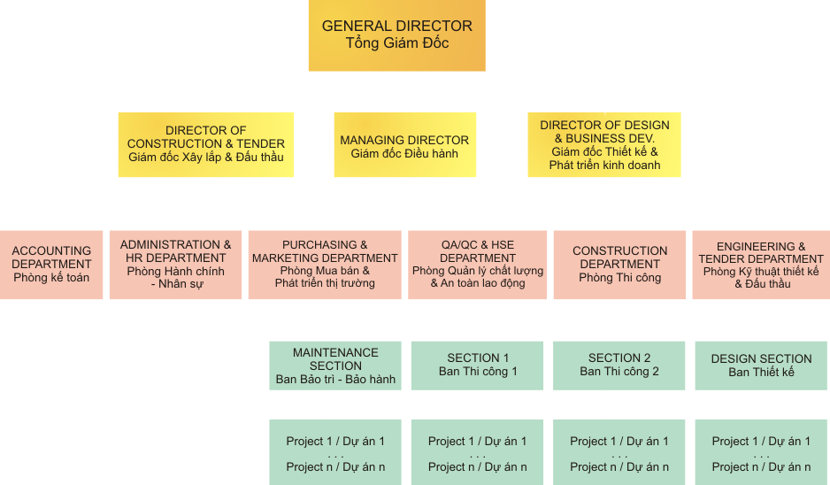
ORGANIZATION CHART

Slide 11
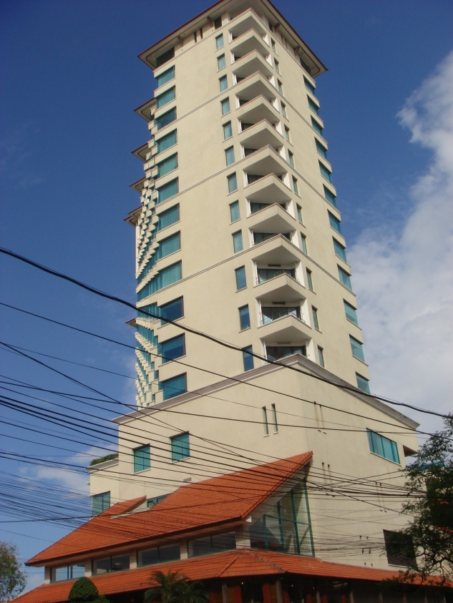
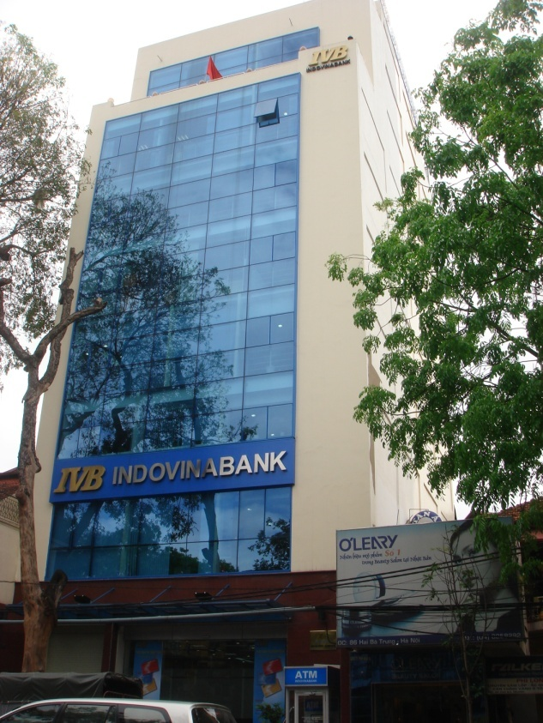
COMPLETED PROJECT
2005
UNITED NATION INTERNATIONAL SCHOOL OF HANOI
Renovation Mechanical and Electrical work
Project amount : 905.000.000,00 VND
STANDLEY VIETNAM FACTORY
Mechanical and Electrical work
Project amount : 620.000.000,00 VND
SOFITEL PLAZA HANOI HOTEL
Renovation mechanical and Electrical work
Project Amount: 17,750. USD
INDOVINA BANK OFFICE BUILDING
Installation of Mechanical and Electrical work
Project amount : 200.000.000,00 VND

Slide 12
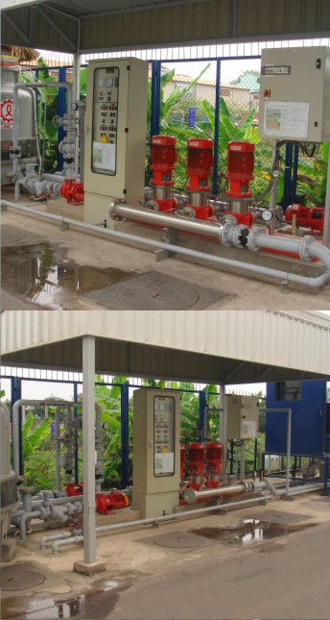
COMPLETED PROJECT
2006
UNITED NATION INTERNATIONAL SCHOOL OF HANOI
Maintenance, Renovation Mechanical and Electrical, gas work
Project amount :871.000.000,00 VND
SOFITEL METROPOLE HANOI HOTEL
Renovation of ACMV work
Project Amount: 136,000. 00 USD
SOFITEL PLAZA HANOI HOTEL
Renovation of Mechanical and Electrical system
Project Amount: 480,000.00 USD
WORLD VISION VIETNAM OFFICE
Supply and install M&E system
Project Amount: 385.000.000,00 VND
GOSHI FACTORY
Installation M&E system
Project Amount: 410.000.000,00 VND

Slide 13
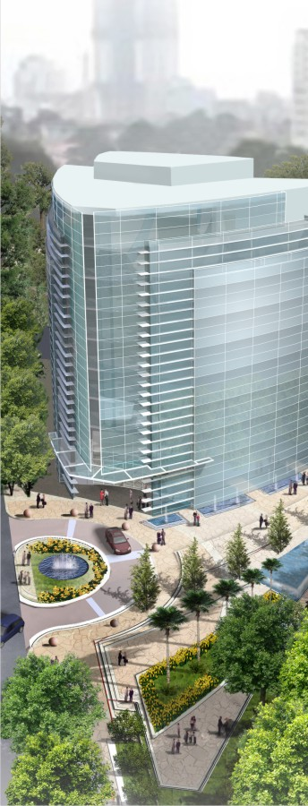
COMPLETED PROJECT
2007
UNITED NATION INTERNATIONAL SCHOOL OF HANOI
Maintenance, Renovation Mechanical and Electrical,
Project amount : 51,000.00 USD
SOFITEL METROPOLE HANOI HOTEL
Renovation of M&E work
Project Amount: 315,000. 00 USD
THAILAND EMBASY IN HANOI
Supply and install new Aircon system, Additional M & E works
Project Amount: 98,000.00 USD
VIETNAM CUSTOM OFFICE BUILDING
Design Electrcal and P&S system
Project Amount: 30,770.00 USD
HUE CUSTOM TRANING CENTRE
Design M & E system
Project Amount: 22,400.00 USD
OPERA PALZA BUILDING
Design M & E system
Project Amount: 25,550.00 USD

Slide 14
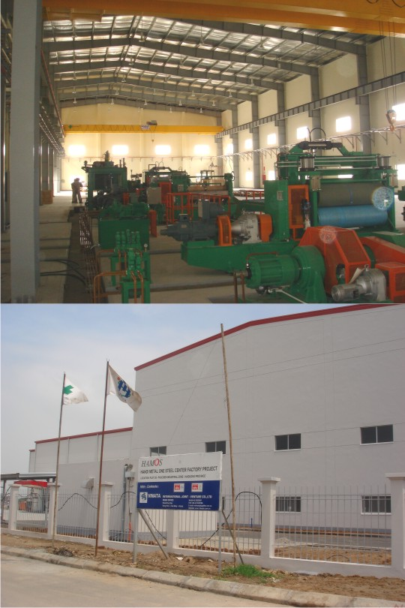
COMPLETED PROJECT
PG BANK
Electrical works
Project Amount: 6,000.00 USD
KPMG OFFICE
Design M & E system
Project Amount: 20,000.00 USD
METAL ONE STEEL FACTORY
M & E works
Project Amount: 61,256.25 USD
PANASONIC OFFICE
M & E works
Project Amount: 9,000.00 USD
HUE CUSTOM TRANING CENTRE
Design M & E system
Project Amount: 22,400.00 USD
GOSHI THANG LONG FACTORY
M&E works, supply lighting
Project Amount: 21,778.74 USD

Slide 15
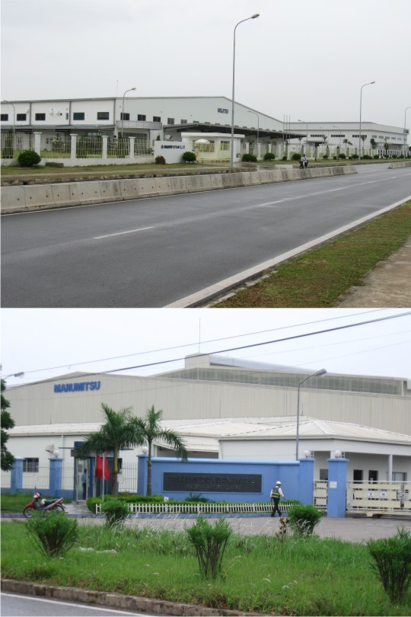
COMPLETED PROJECT
2008
YAMAHA MOTOR FACTORY
Supply lighting
Project amount : 32,700.00 USD
MARUMITSU FACTORY
Supply lighting
Project amount : 15,271.30 USD
NAGATSU FACTORY
Supply lighting
Project amount : 30,000.00 USD
UNITED NATION INTERNATIONAL SCHOOL OF HANOI
Maintenance M&E works, Supply and Install Electrical works
Project amount : 78,000.00 USD
ENDO FACTORY
Mechanical works
Project amount : 36,231.25 USD
DONG LOI HOTEL
Design Mechanical and Electrical system
Project amount : 12,000.00 USD
TRANSMERCO
Local consultant for MEP work
Project amount : 20,000.00 USD

Slide 16
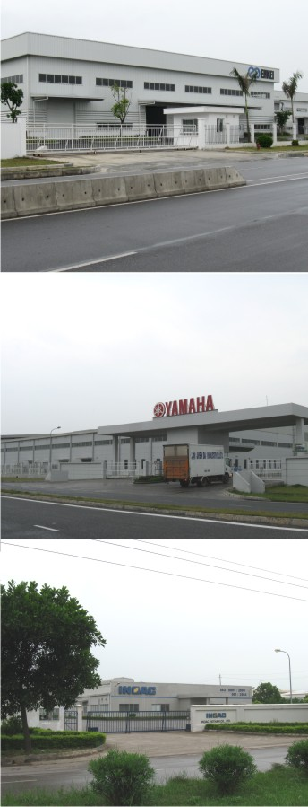
COMPLETED PROJECT
SOFITEL PLAZA HANOI
Upgrade exhaust fan
Project amount : 31,030.45 USD
SOFITEL METROPOLE HANOI HOTEL
Renovation, design and build M&E system
Project amount : 1,318,359.55 USD
ENKEI VIET NAM FACTORY
Electrical works
Project amount : 113,252.73 USD
AUSTRALIA EMBASSY HANOI
Supply and Install M&E works
Project amount : 81,000.00 USD
FEDERAL EXPRESS OFFICE & WAREHOUSE AT NOIBAI AIRPORT
Supply and Install M&E works, new meeting room
Project amount : 110,220.00 USD
INOAC FACTORY
Supply Lighting
Project amount : 10,252.73 USD
YAMAHA FACTORY
Supply Lighting
Project amount : 11,852.73 USD
41 LY THAI TO BUILDING
Design Mechanical and Electrical system
Project amount : 7,000.00 USD

Slide 17
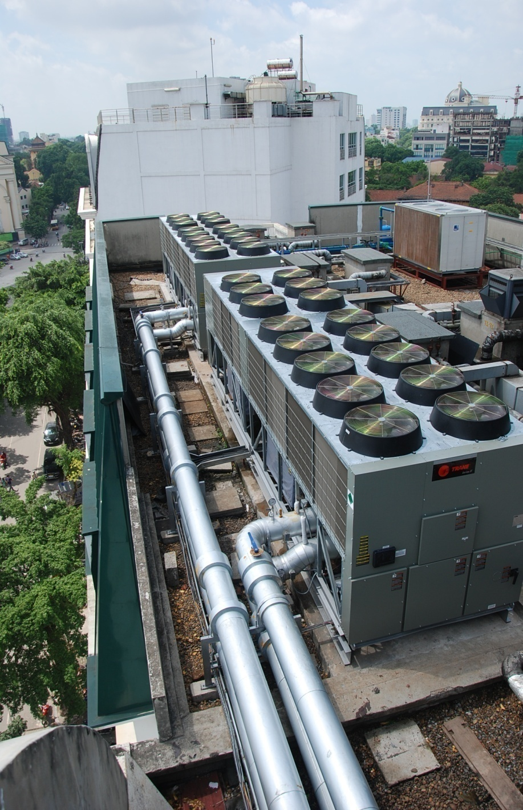
COMPLETED PROJECT
2009
UNITED NATION INTERNATIONAL SCHOOL OF HANOI
Maintenance Mechanical and Electrical works
Project amount : 126,000.00 USD
SOFITEL METROPOLE HANOI HOTEL
Renovation, supply and install M&E system
Project amount : 1,425,000.00 USD
HANOI TOWER CENTER
Renovation of ACMV system
Project amount : 104,000.00 USD
KINDER WORLD - HA THANG BUILDING
Electrical works
Project amount : 700.000.000,00 VND
GAMUDA LAND
M & E for Mock up and Waterfront park
Project amount : 284,000.00 USD
1A-01 HIGH-RISE APARTMENT - ECOPARK
M & E design works
Project amount : 155,000.00 USD
HONG KONG TOWER
M & E design works
Project amount : 55,000.00 USD
BUNKA VIET NAM
Supply Lighting
Project amount : 22,000.00 USD

Slide 18
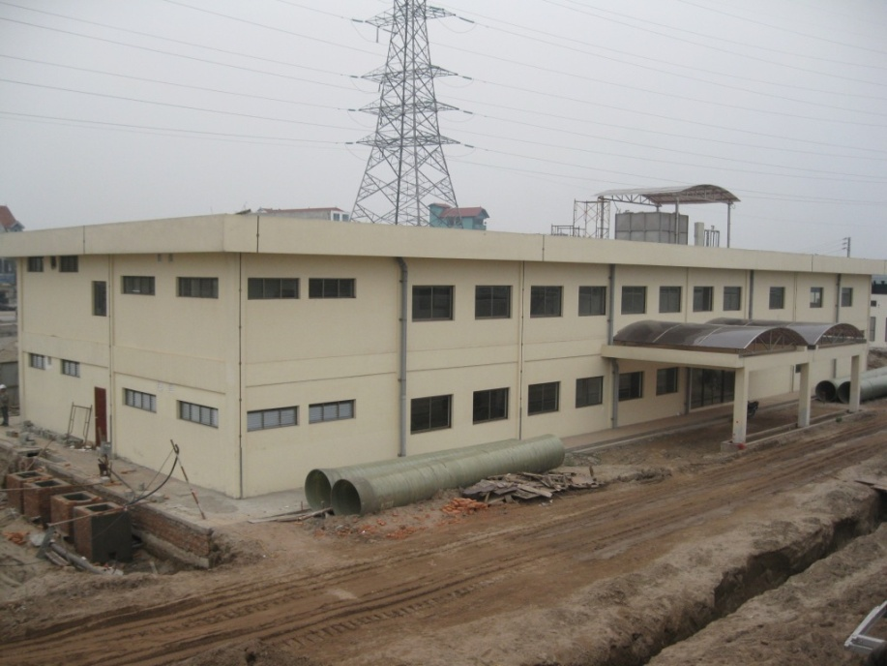
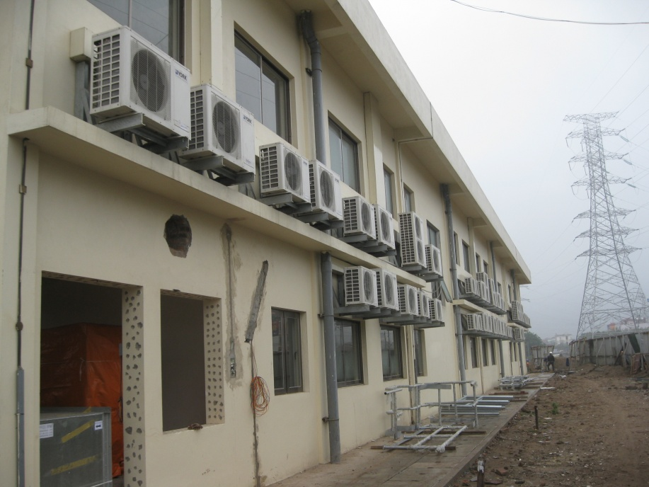
COMPLETED PROJECT
2010
INAX VIET NAM PHASE 5
Supply Lighting
Project amount : 15,000.00 USD
YAMAHA VIET NAM FACTORY
Renovation of M & E works
Project amount : 146,740.00 USD
UNITED NATION INTERNATIONAL SCHOOL OF HANOI
Mechanical & Electrical works for Relocation of Outdoor Units Aircons
Project amount : 136,000.00 USD
YAMAHA VIETNAM FACTORY
Renovation of M&E system and Instruments work
Project amount : 94,500.00 USD
SUMITOMO HEAVY INDUSTRY FACTORY
Renocation of M&E system
Project amount: 87,000. 00 USD
METROPOLE HANOI HOTEL
Maintenance of M&E system
Project amount: 15,000. 00 USD
CENTRAL EYE HOSPITAL
Supply Lightning system.
Project amount: 285,000.000. 00 VND

Slide 19
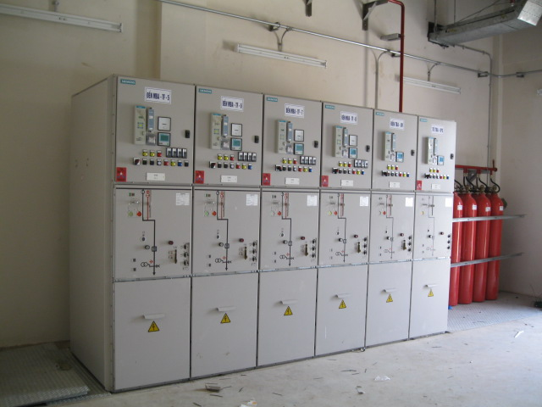
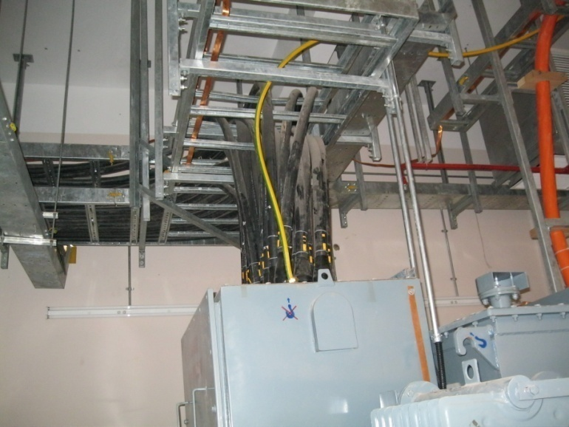
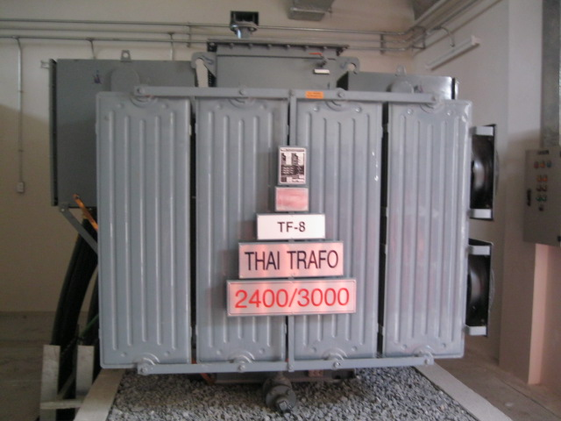
CURRENT PROJECT
GAMUDA ENGINEERING/ GAMUDA LAND
Supply and insall 22kv Substation and network
Project amount : 440,000.00 USD
GAMUDA ENGINEERING/ GAMUDA LAND
Mechanical & Electrical works for Admin building
Project amount : 4.600.000.000,00 VND
YENSO STP PLAN/ GAMUDA ENGINEERING
Electrical works for STP plant
Project amount : 1,200,000.00 USD

Slide 20
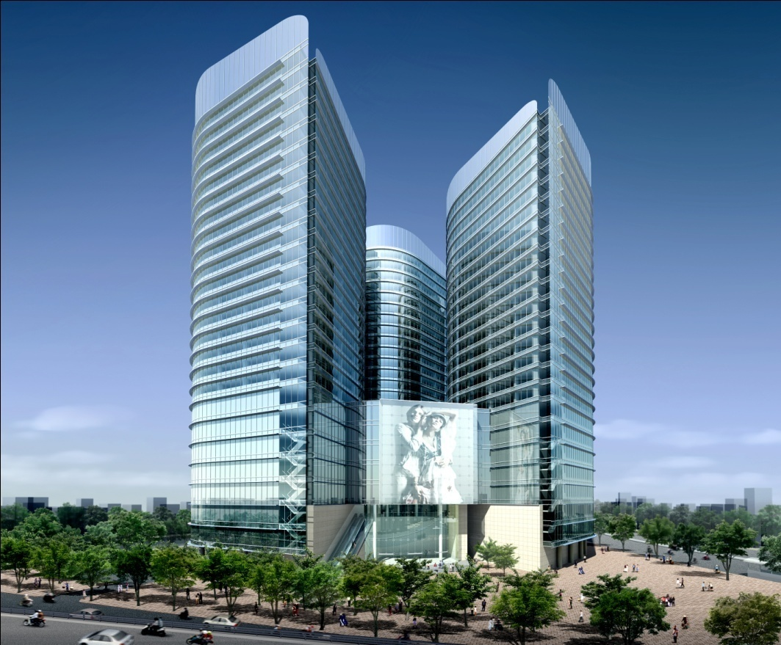
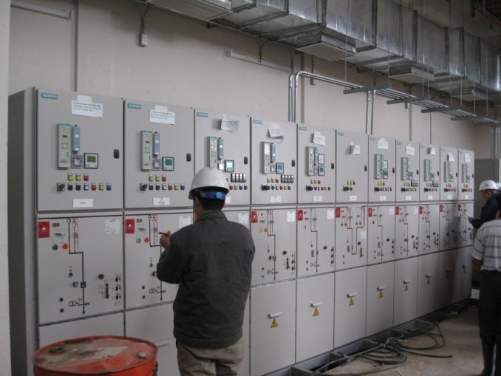
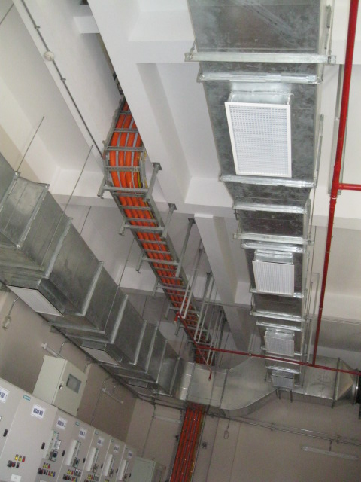
CURRENT PROJECT
UNITED NATION INTERNATIONAL SCHOOL OF HANOI
Supply and install M & E works for new building 4 and building 10
Project amount : 41.470.000,000.00 VND
NGA TU SO TRADE CENTER
Local consultant for Mechanical & Electrical service -design
Project amount : 190,000.00 USD

Slide 21
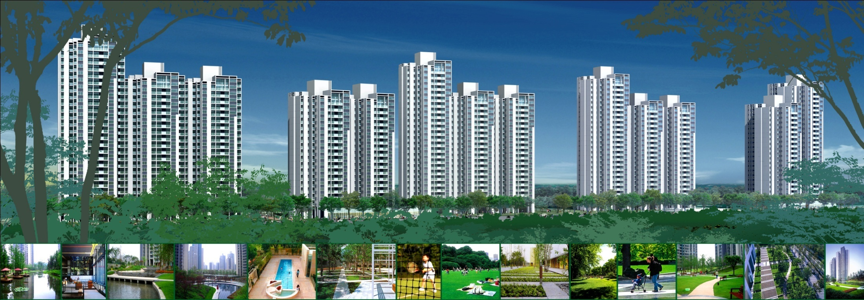
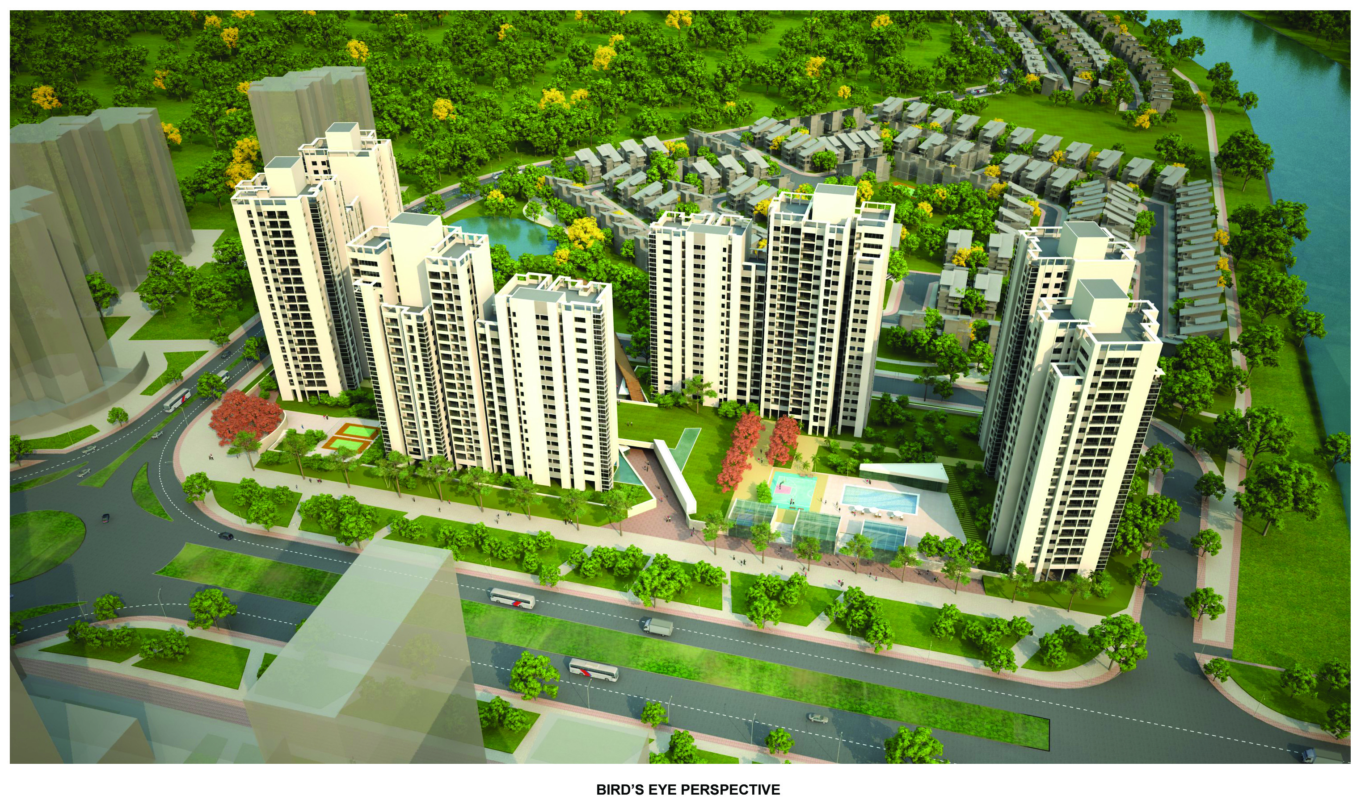
CURRENT PROJECT
ECOPARK APARTMENT 1B-02,03
Local consultant for Mechanical & Electrical services - design
Project amount : 180,000.00 USD

Slide 22
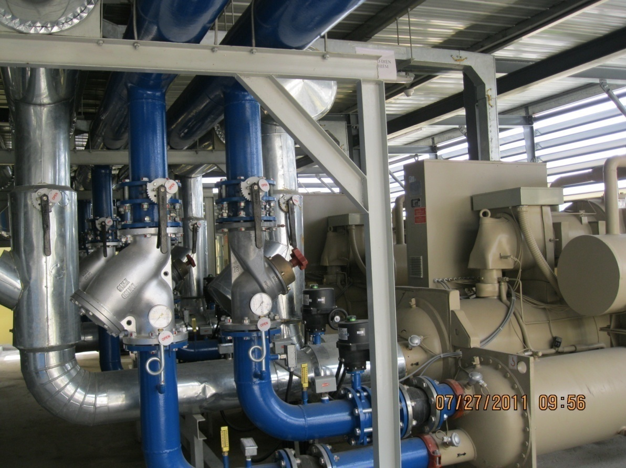
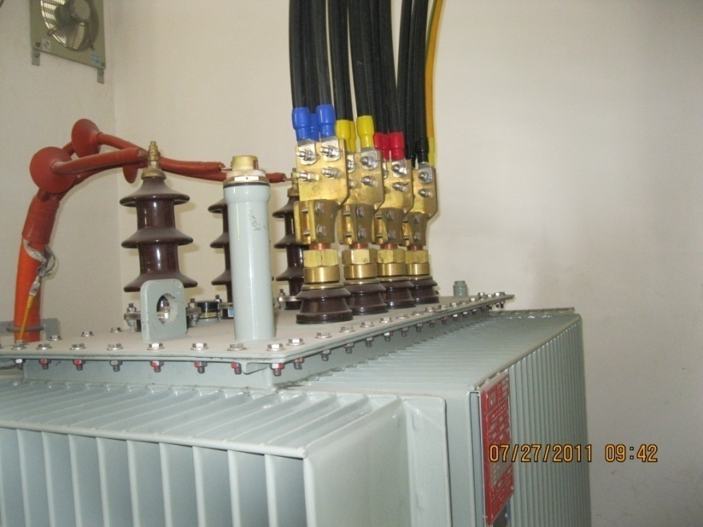
CURRENT PROJECT
TECHCOM BANK DATA CENTRE
ACMV work for data centre
Project amount : 129,800.00 USD
HANOI TOWER CENTRE
Renovation of ACMV system for office block
Project amount : 242,000.00 USD

Slide 23
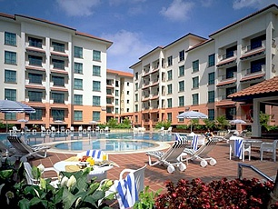
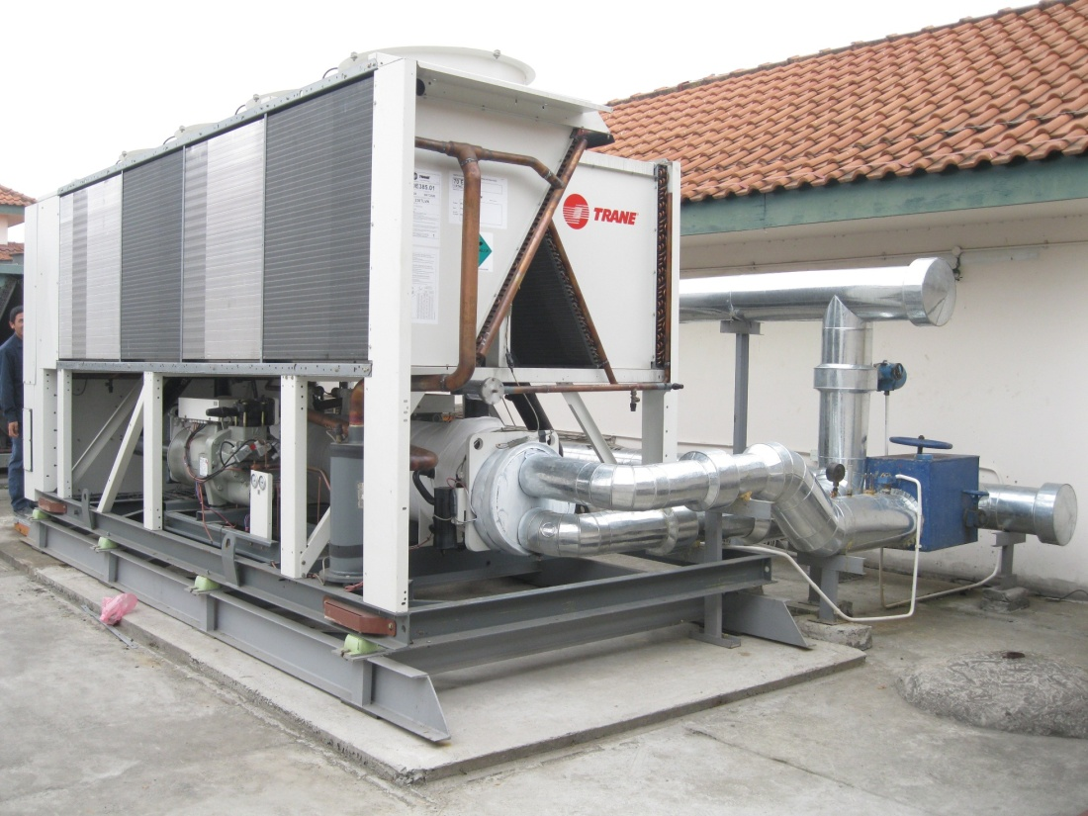
CURRENT PROJECT
SEDONA SUITE
Supply equipemnts and technical support
Project amount : 96,800.00 USD
UNITED NATION INTERNATIONAL SCHOOL OF HANOI
Maintenance Mechanical and Electrical system
Project amount : 58,600.00 USD
UNITED STATE OF AMERICA EMBASSY
Supplied M&E system and techincal support
Project amount : 789,800.00 USD

Slide 24
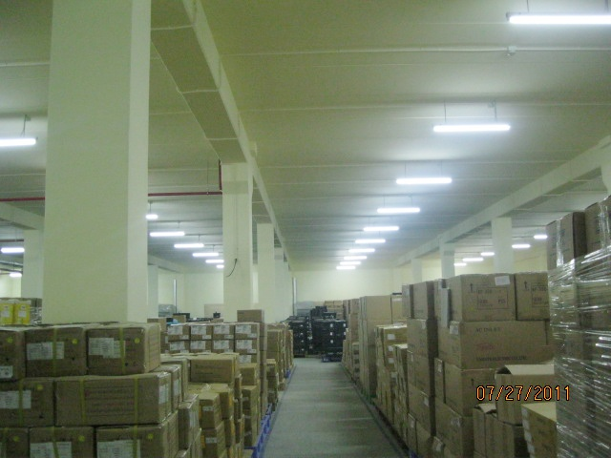
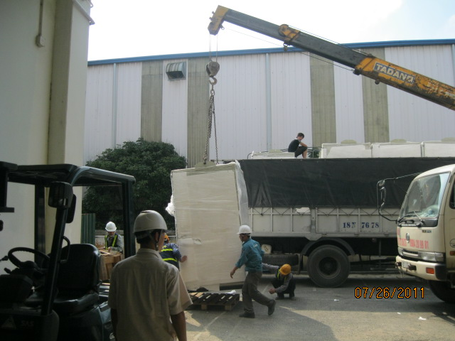
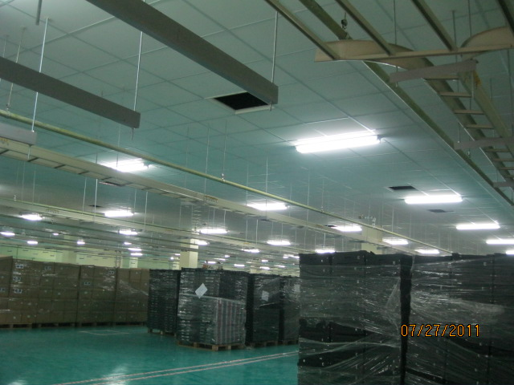
CURRENT PROJECT

Slide 26
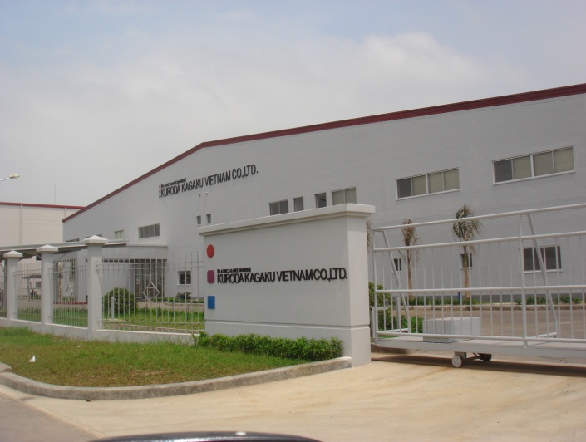
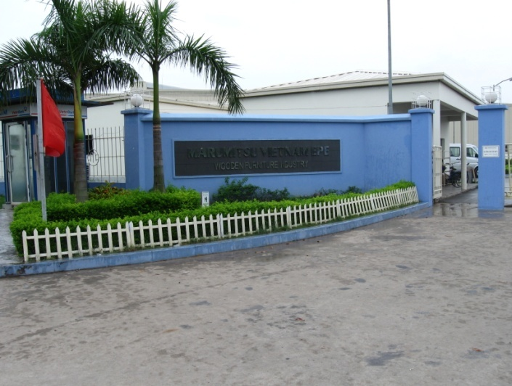
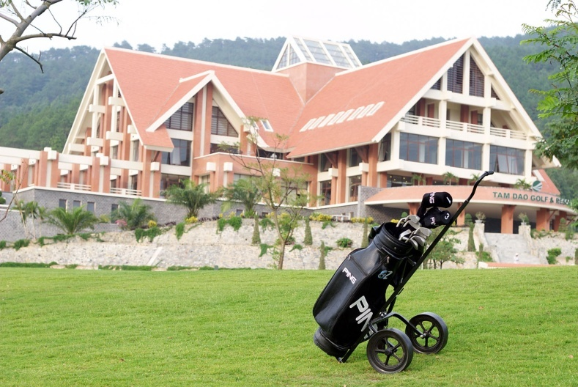
QUALITY ASSURANCE PROCEDURE
GOAL OF QUALITY ASSURANCE (QA):
1. To achieve customer' satisfaction
2. To reduce the lost construction cost which caused by:
Select wrong supplier or sub-constructor.
Work delay.
Work redone by wrong installation or wrong material used.
Using low quality material or equipment causing to be replaced.
Big and widely trouble caused from unforeseen risk due to the above maters.

Slide 27
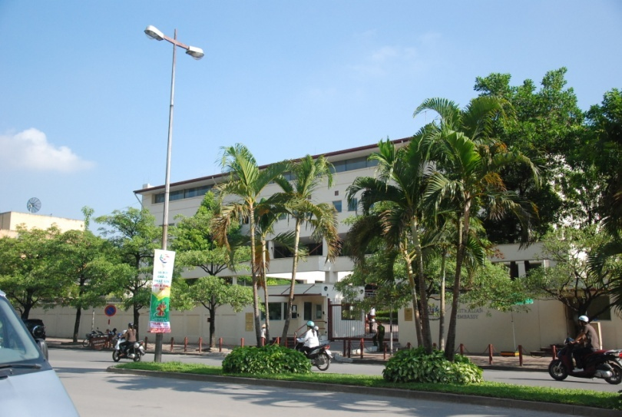
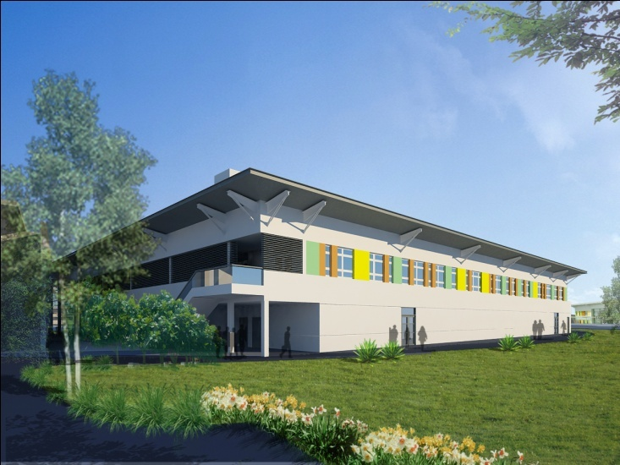
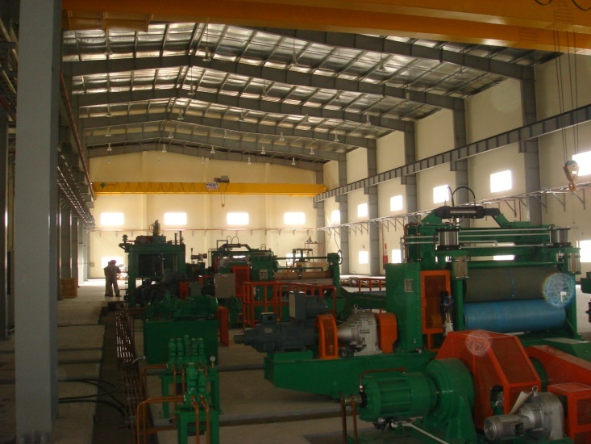
QUALITY ASSURANCE PROCEDURE
SUBJECTS NEED TO BE CONTROLLED:
1. Suppliers or Sub-contractor.
2. Company information and documents.
3. Company Logistic.
4. Storage (Including Field storage).
5. Tools and measurement equipment.
6. Construction work.
7. Safety.
8. Record and Audit.

Slide 28
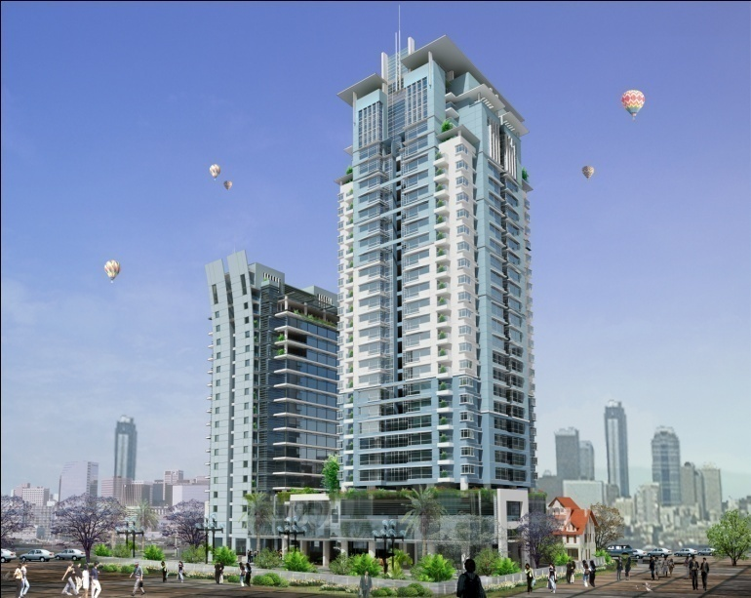
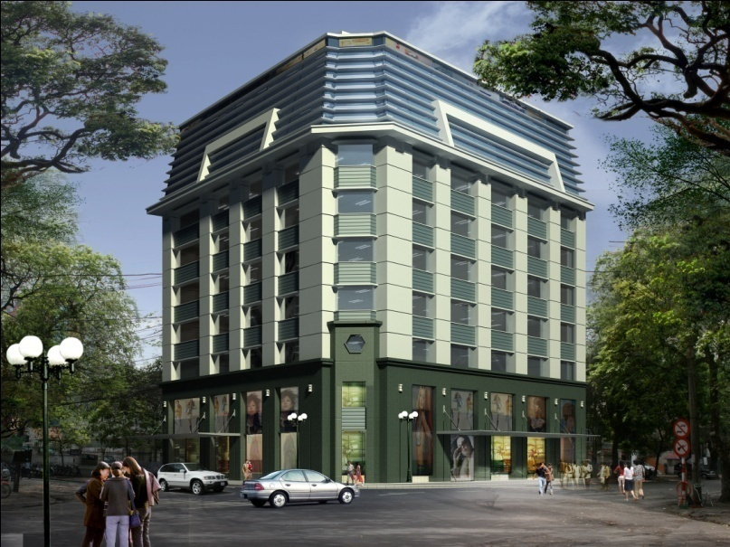
QA/QC MANUAL
Statement of policy
The intent of this manual is to provide a basic guideline for the day-to-day operations to ensure that VTE's high quality standards of workmanship is achieved.
All VTE personnel shall use the contents of the Quality Assurance Manual and no deviations from the methods set forth herein shall be permitted, unless clearly authorized by the Quality Control Manager, Project Manager, and the VTE MD/CEO.

Slide 29
QA/QC MANUAL
Project quality commitment
The Quality Assurance Manual is modeled to suit the requirements of ISO 9001. The procedures included in this Manual are intended to be used as a first level in the hierarchy of the Company's Quality Assurance System. Statutory Regulations, Government Controls and other applicable local laws (which form the base level), are automatically adopted into the First Level. Examples of such regulations include Requirements for Safety Certification of moving equipment, Certification of all Crane Operators, etc.
The Second Level in the Quality management system is formed by the Internal Department Procedures which are developed based on the Quality Assurance Manual. The Quality Assurance/Quality Control Department also provides input at this level in terms of Audit Procedures and generation and maintenance of historical data records.
Project-specific procedures (compiled to form “Project Quality Plan”) as required may be developed based on the procedures included in this Manual. This then forms the Third Level in the Q.A. System.
Based on the Project Quality Plan described above, individual Project Engineers and Supervisors will be provided with concise instruction sheets on the implementation of relevant aspects of the applicable Quality Plans. This forms the basis of applying the precepts of the written documents to daily work practices.
Audits may be conducted on the Quality Assurance/Quality Control Department and/or its designated representatives or third party Accreditors. Deviations observed in the work system shall be reported back to the Management to concur with the Quality Assurance Department. Suitable changes as necessary may be incorporated appropriately.

Slide 30
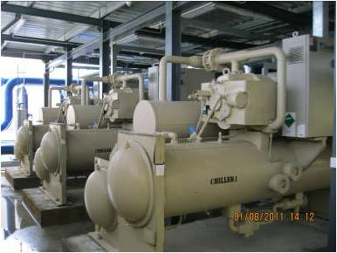
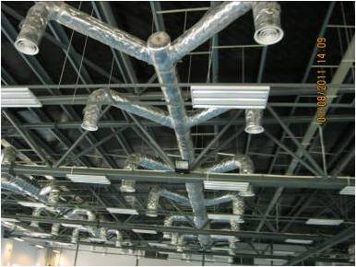
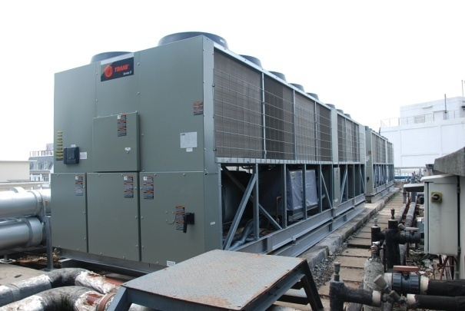
I. QA/QC MANUAL CONTENTS
Introduction
The Quality Plan is the principal quality document for all VTE projects and will be content:
Scope Application, purpose and Definition and reference
Project Quality system : project managemnet, engineering services, procurement Services...
Project organisation and responsibilities
Documentation : Punch list, Retention of record...

Slide 31
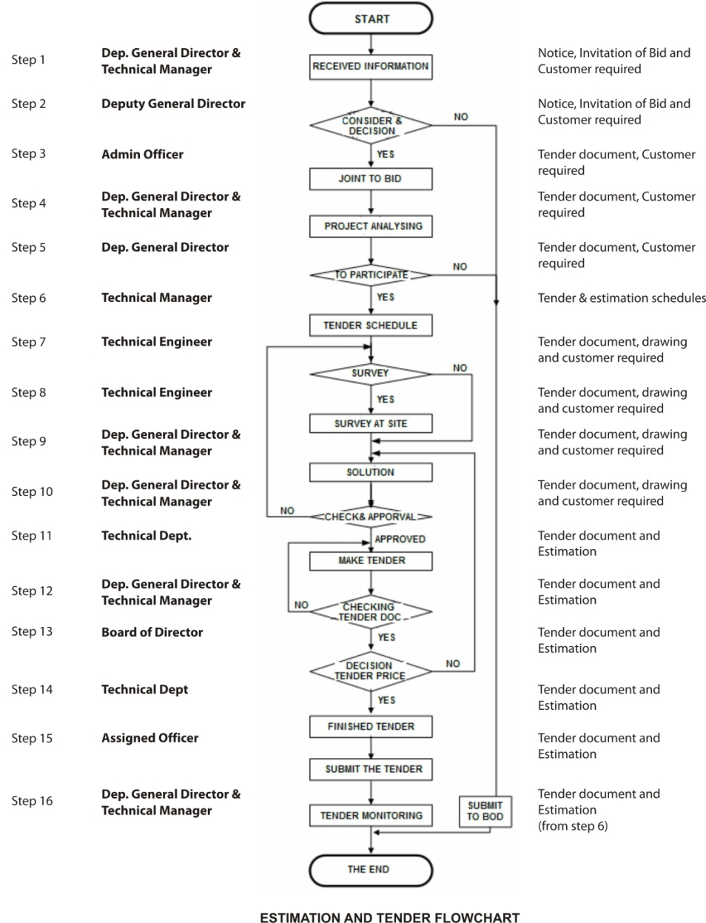
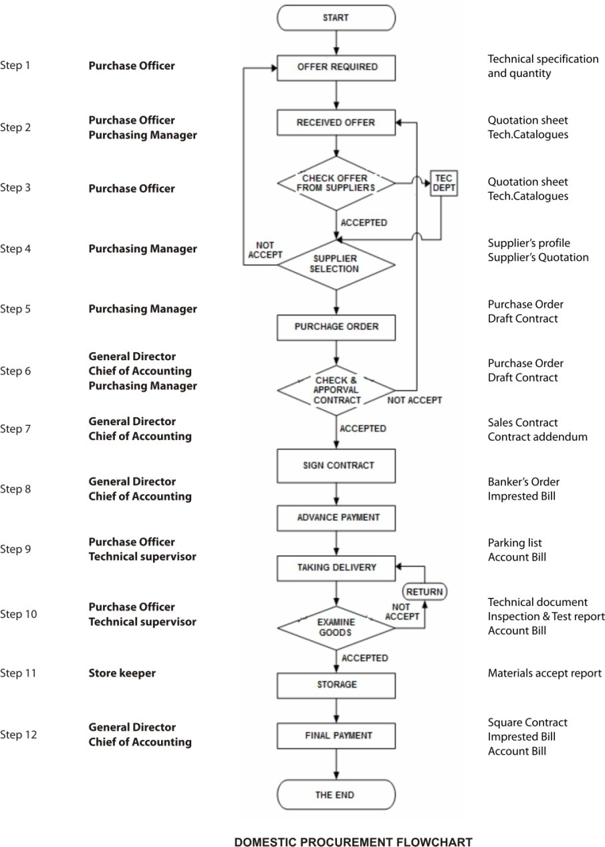
QA/QC FLOWCHART
STEP | PERSON IN CHARGE | FLOWCHART | DOCUMENTS
STEP | PERSON IN CHARGE | FLOWCHART | DOCUMENTS

Slide 32
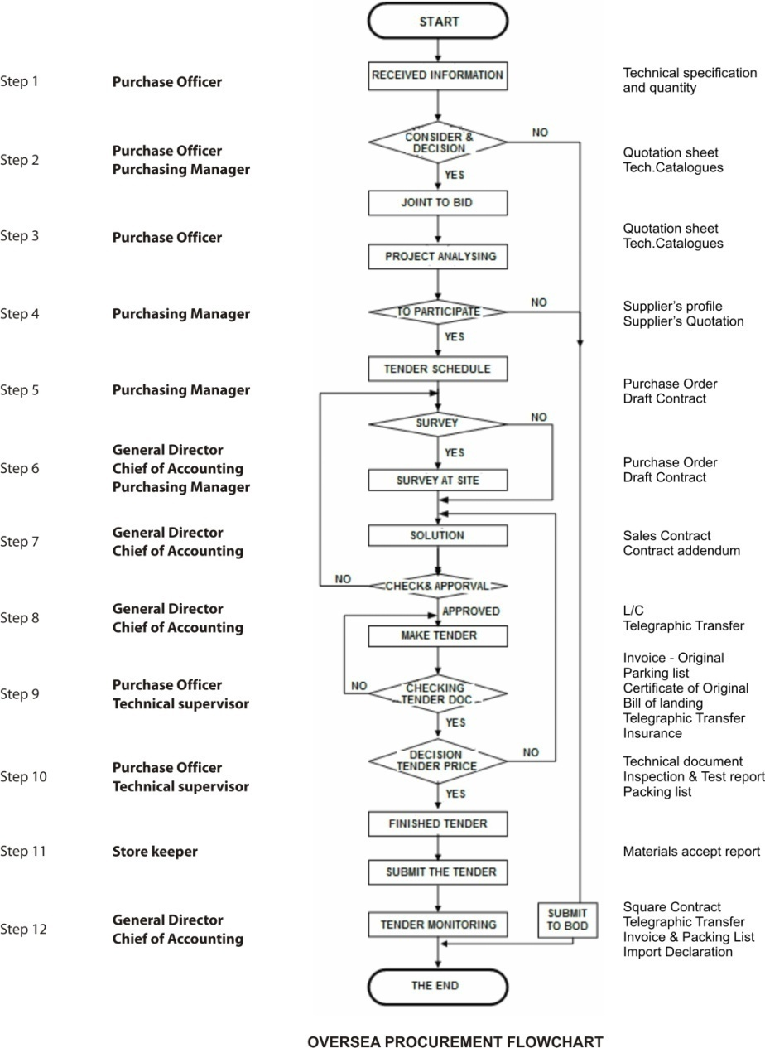
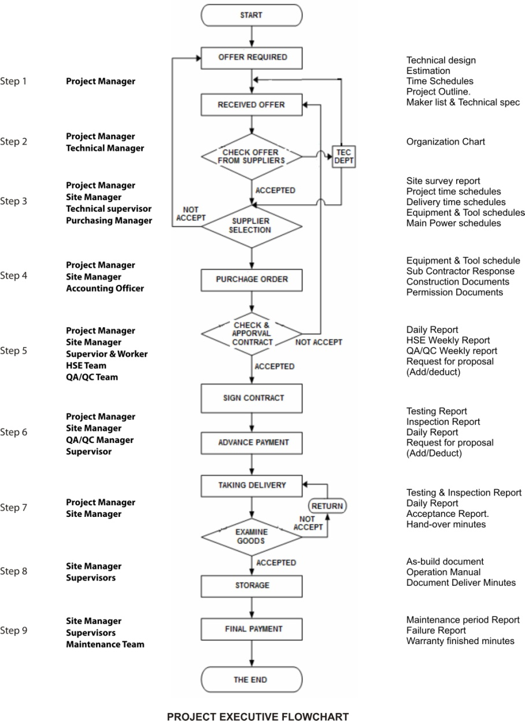
QA/QC FLOWCHART
STEP | PERSON IN CHARGE | FLOWCHART | DOCUMENTS
STEP | PERSON IN CHARGE | FLOWCHART | DOCUMENTS

Slide 33
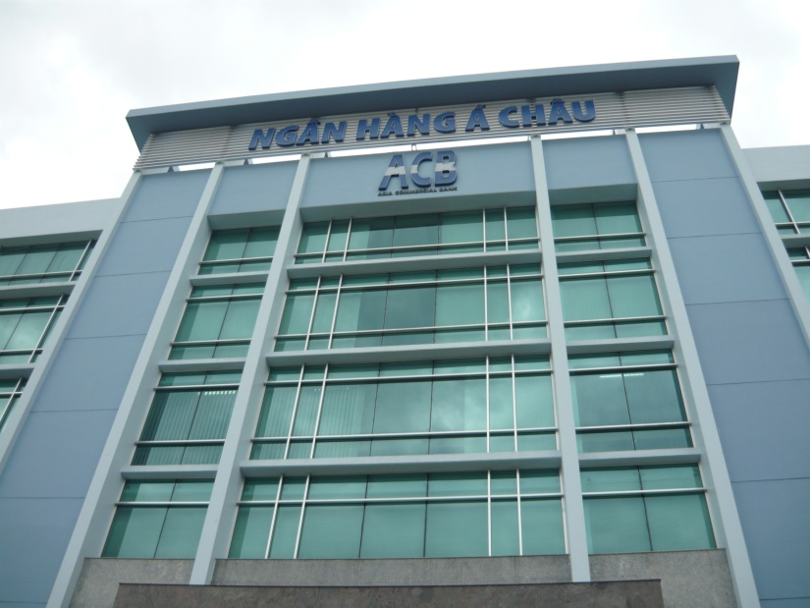
QUALITY ASSURANCE PROCEDURE

Slide 34
SITE M&E QUALITY CONTROL FORMS LIST
1.
2.
3.
4.
5.
6.
7.
8.
9.
10.
Chỉ thị công trường
Site Instruction
Ghi nhớ công trường
Site Memo
Phê duyệt hệ thống ống ngầm
Request Approval for Underground Piping
Yêu cầu phê duyệt hồ sơ
Request for Document Approval
Trình mẫu vật tư thiết bị để phê duyệt
Materials/ Equipments submission for Approval
Yêu cầu nghiệm thu vật tư/thiết bị về công trường
Delivery inspection request
Yêu cầu nghiệm thu
Request for Inspection
Phê duyệt công tác lắp đặt thiết bị vệ sinh
Approval for Sanitary works
Kiểm tra và nghiệm thu mô tơ điện
Testing and Commissioning Motor
Kiểm tra và nghiệm thu hệ thống chống sét đánh thẳng
Testing and Lightning Protection System
11.
12.
13.
14.
15.
16.
17.
18.
19.
20.
Kiểm tra và nghiệm thu tủ bảng điện hạ thế
Testing and Commisioning Low Voltage Board
Kiểm tra và nghiệm thu máy biến thế
Testing and Commisioning Power Transformer
Kiểm tra và nghiệm thu cáp điện
Testing and Commissioning Cable
Kiểm tra và nghiệm thu hệ thống chiếu sáng
Testing and Commsioning Lighting System
Kiểm tra và nghiệm thu hệ thống tiếp địa
Testing and Commsioning Earthing System
Kiểm tra và nghiệm thu hệ thống Camera
Testing and Commisioning Camera System
Kiểm tra và nghiệm thu hệ thống thang, máng cáp
Testing and Commisioning Cable ladder, Trunking Tray
Kiểm tra và nghiệm thu hệ thống ống điện
Testing and Commisioning Conduit for Electric System
Kiểm tra và nghiệm thu hệ thống điều hòa không khí
Testing and Commsioning for Air Conditioning system
Kiểm tra và nghiệm thu hệ thống quạt thông gió
Testing and Commisioning Ventilation fan

Slide 35
SITE M&E QUALITY CONTROL FORMS LIST
21.
22.
23.
24.
25.
26.
27.
28.
29.
30.
Kiểm tra và nghiệm thu hệ thống ống chữa cháy
Testing and Commisioning Fire Hydrant system
Kiểm tra và nghiệm thu hệ thống ống
Testing and Commsioning Pipe
Kiểm tra và nghiệm thu hệ thống cân bằng gió
Testing and Commisioning Air Balance
Kiểm tra và nghiệm thu bơm
Testing and Commisioning Pump
Kiểm tra và nghiệm thu hệ thống báo cháy
Testing and Commisioning Fire Alarm System
Kiểm tra và nghiệm thu hệ thống tưới cây
Testing and Commisioning Water Garden System
Kiểm tra và nghiệm thu hệ thống bọt foam cho bồn dầu
Testing and Commisioning Fire Foam System for Oil Tank
Kiểm tra và nghiệm thu hệ thống bình điều áp
Testing and Commissioning Expansion Tank
Báo cáo công việc hàng ngày
Site Daily Report
Báo cáo công việc hàng tuần
Weekly Field Report
31.
32.
33.
34.
35.
Hồ sơ cảnh cáo không làm đúng theo yêu cầu
Warning for Non-Compliance
Mẫu yêu cầu làm việc
Request for Working
Kiểm tra và nghiệm thu áp lực đường ống
Pressure testing and Commissioning pipe
Mẫu yêu cầu làm việc ngoài giờ
Request for Working Over Time
Yêu cầu cung cấp thông tin
Request for Informationz

Slide 37
SAFETY POLICY
1.1 HSE Policy
The final goal of VTE’s HSE philosophy is to ensure the HSE of personnel, to eliminate property damage and to provide a safe and comfortable working and living environment, during the entire construction period. Contractor will maintain it’s own HSE philosophy as described below.
- The HSE is a paramount consideration in the project.
- All accidents are preventable.
- All tasks shall be planned and performed with concern for HSE and work planning
shall include an assessment risk.
- HSE is a line management responsibility.
- Identify and eliminate or minimize inherent hazard in the work.
- Closely monitor each steps of the work to detect and promptly eliminate hazards and
unsafe practices.
- Provide clear and concise written instruction, rules and plans for the work to be
performed.
- Use trained and qualified workers and supervisors.
- Recognize and reward outstanding performance.
- Provide personnel protective equipment.
- Provide proper mechanically sound tools and equipment.
- Maintain fire prevention and protection program.
Provide first aid and medical facility.
1.2 Alcohol and Drug Policy
It is a termination offence for any employee of Contractor to be under the influence of alcohol, or in possession of or under the influence of any non- prescribed drug, such as cocaine, Marijuana, Heroin, Hashish, or other illegal substance, while working or residing on any job site, including all operations, or property under the control of Contractor. This rule applies to all operations and all location.
1.3 Smoking Policy
Smoking is not only harmful to health but also a potential HSE hazard. Smoking and the use of naked flame are strictly prohibited in the work-site. Lighters and matches shall not be brought in except in approved area. "Smoking" is only allowed at approved areas displayed with smoking signs. Smokers who smoke at approved areas must ensure that cigarette butts and ash are properly disposed in proper sand-box or ash-tray provided.
VIET TIEN ENGINEERING J.S COMPANY
Director

Slide 38
SAFETY ORGANIZATION CHART

Slide 39
EMERGENCY ORGANIZATION CHART

Slide 40
SAFETY RULE BOOK
GENERAL
VIET TIEN ENGINEERING JOINT STOCK COMPANY has made serious commitment to Safety. In addition to the humanitarian reasons for preventing personal injury, increased awareness and attention to safety by everyone is essential to the economic health of the construction industry.
This booklet is issued to identify certain safety and work rules that are mandatory for all individuals on this project. Following these rules will contribute significantly to your well being and a successful completion of the project. Violation of some of these rules may result in immediate dismissal.
Accidents can be prevented through use of good judgement and common sense. By following safe practices along with all of our safety regulations, those of our customer and applicable governmental regulations, you can help us in making this project a safe place of employment for yourself and your fellow employees. Remember that everyone loses from an accident. We are concerned with your safety. Help us keep you safe!
“If you don’t know the safe way we’ll teach you. If you won’t work safely, you won’t work here”.

Slide 41
SAFETY RULE BOOK
A. SAFE PROGRAM RULES
B. GENERAL SAFE PRACTICES
C. EMERGENCY PROCEDURES
D. HOUSEKEEPING
E. FOR YOUR PERSONAL PROTECTION
F. MATERIAL HANDLING
G. TRANSPORTATION
H. ELECTRICAL
I. EXCAVATION AND TRENCHES
J. WELDING AND CUTTING
K. LADDERS AND SCAFFOLDS
L. HAND TOOLS
M. EQUIPMENT AND MACHINERY
N. FIRE PREVENTION
O. RADIATION SAFETY
P. OFFICE SAFETY
Q. PARKING FACILITIES AND ACCESS TO THE PLANT
R. IDENTIFICATION
S. CONDUCT ON THE JOB
T. JOB INJURIES AND SICKNESS
U. SANITARY FACILITIES
V. REMAINING IN WORK AREAS

Slide 42
SAFETY FORM AND CHECKLIST
1
2
3
4
5
6
7
8
9
10
11
12
13
14
15
16
17
18
19
20
Job safety Analysis
Safety Induction check list
Refreshment Safety Training
Monthly safety report
Daily Site Safety Report
Hazard Tracking
Yellow card penalties
Red Card penalties
Accident report
Warning of non compliance
Request for Work in Overtime
Confined Space Permit
Excavation Permit
Hotwork Permit
Radiography Permit
Incident-Near Miss Report
Offences and Disciplinary actions
Weekly Site Safety Inspection
Set of PDF-HSE
Scaffolding safety checklist

Slide 43
SAFETY ACTIVITIES

Slide 44
SAFETY ACTIVITIES

Slide 45
SAFETY ACTIVITIES

Slide 46
SAFETY ACTIVITIES

Slide 47
SAFETY ACTIVITIES

Slide 48
Thank you

